Slide 1
SVM classification

Slide 2
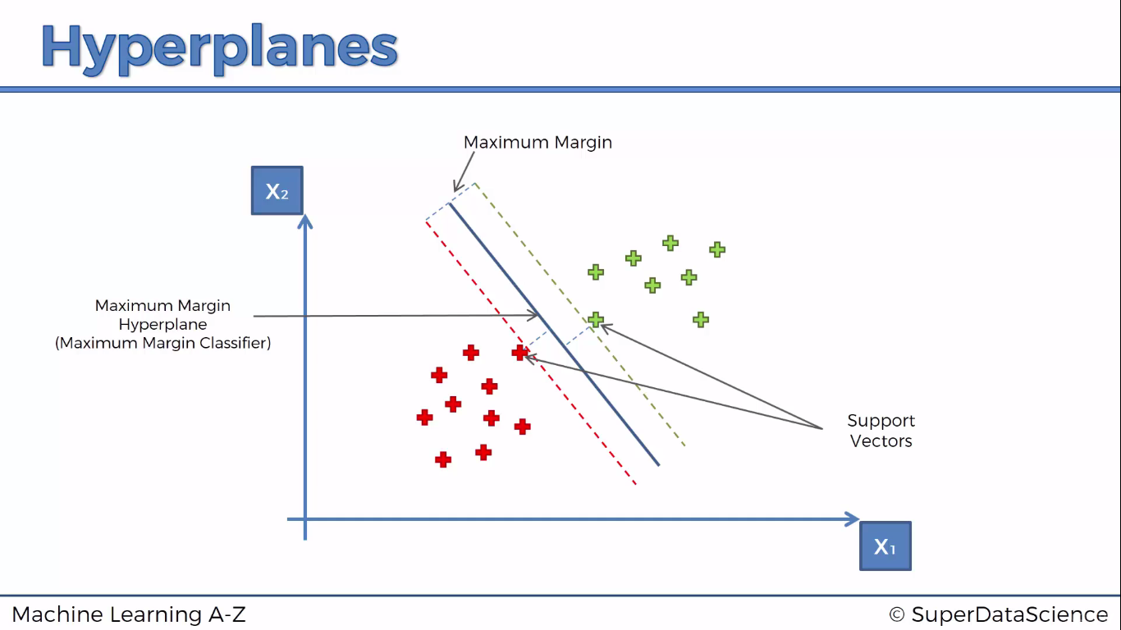

Slide 3
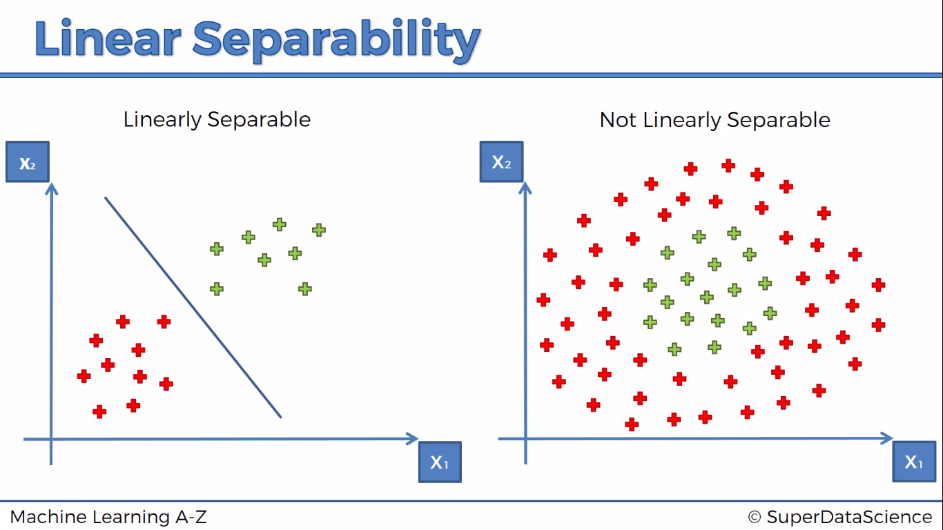

Slide 4
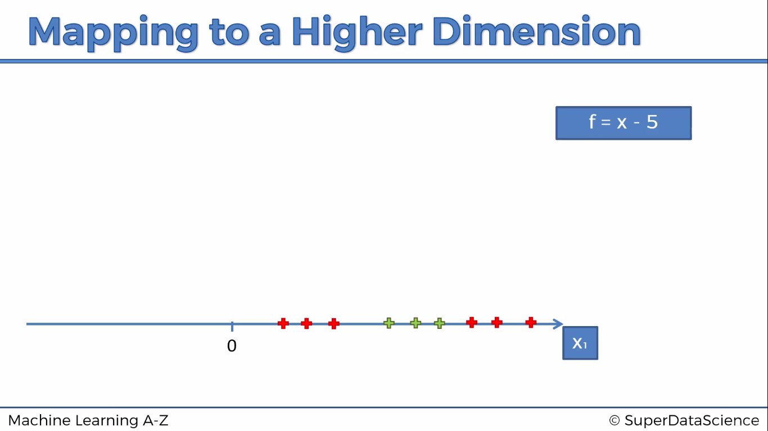

Slide 5
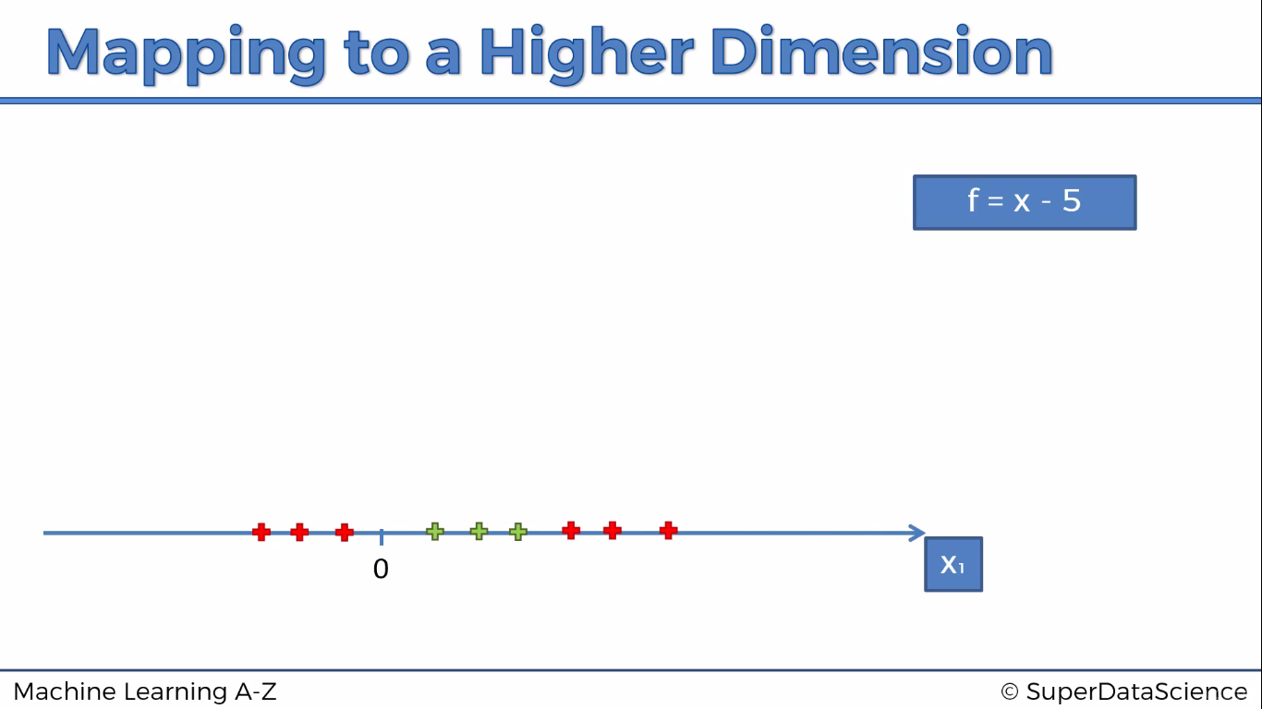

Slide 6
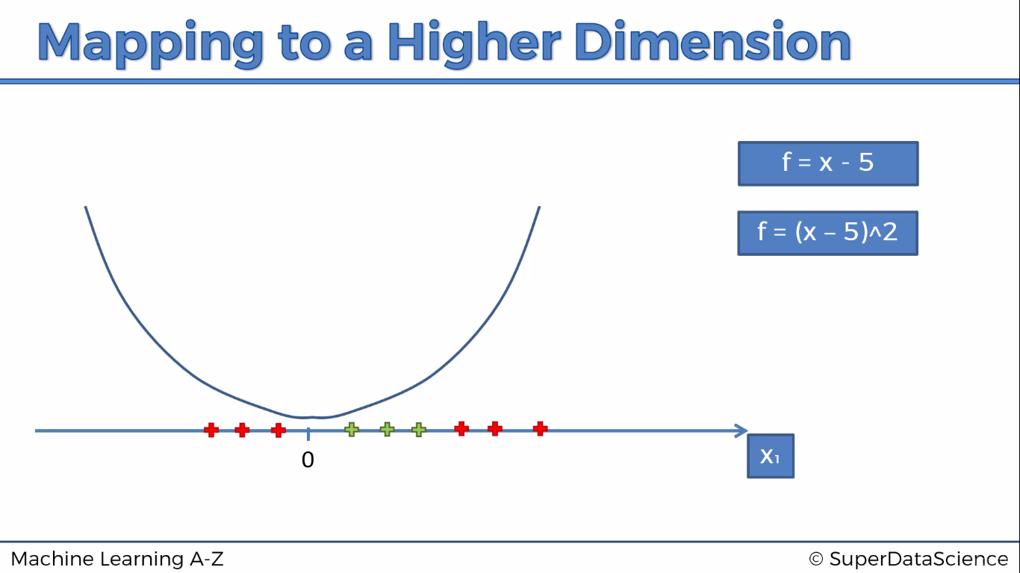

Slide 7
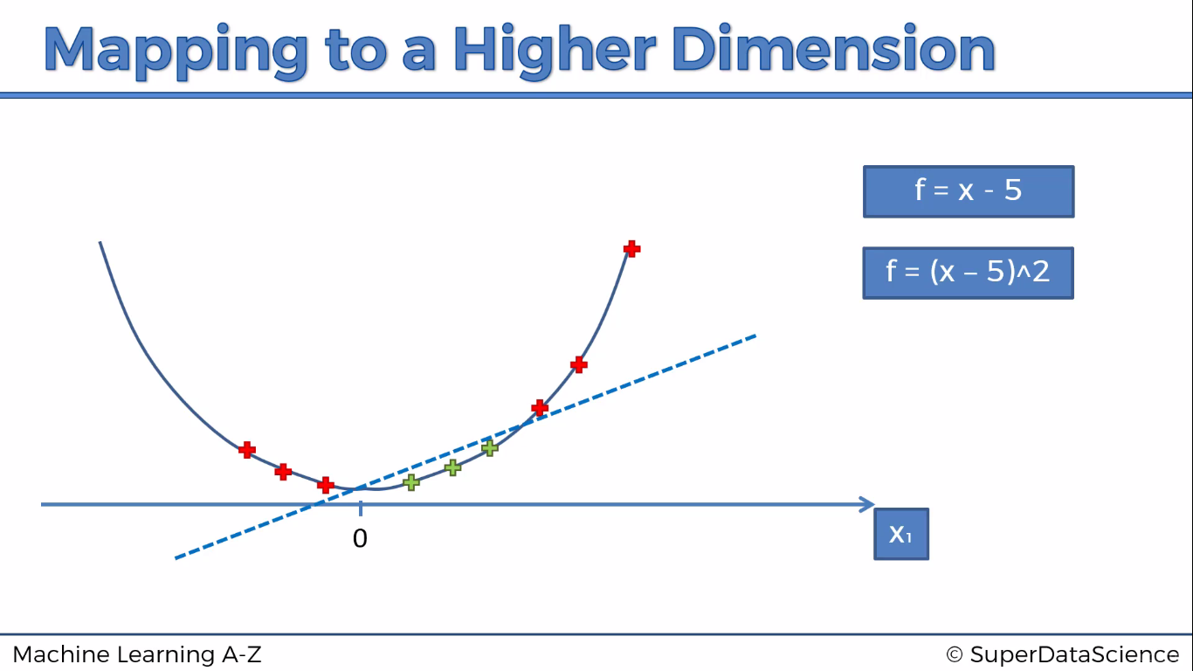

Slide 8
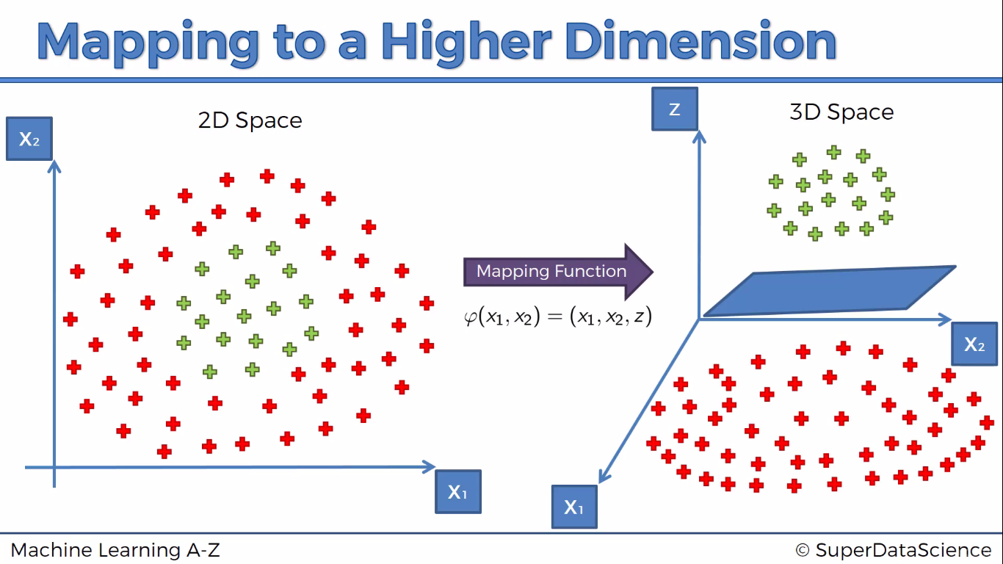

Slide 9
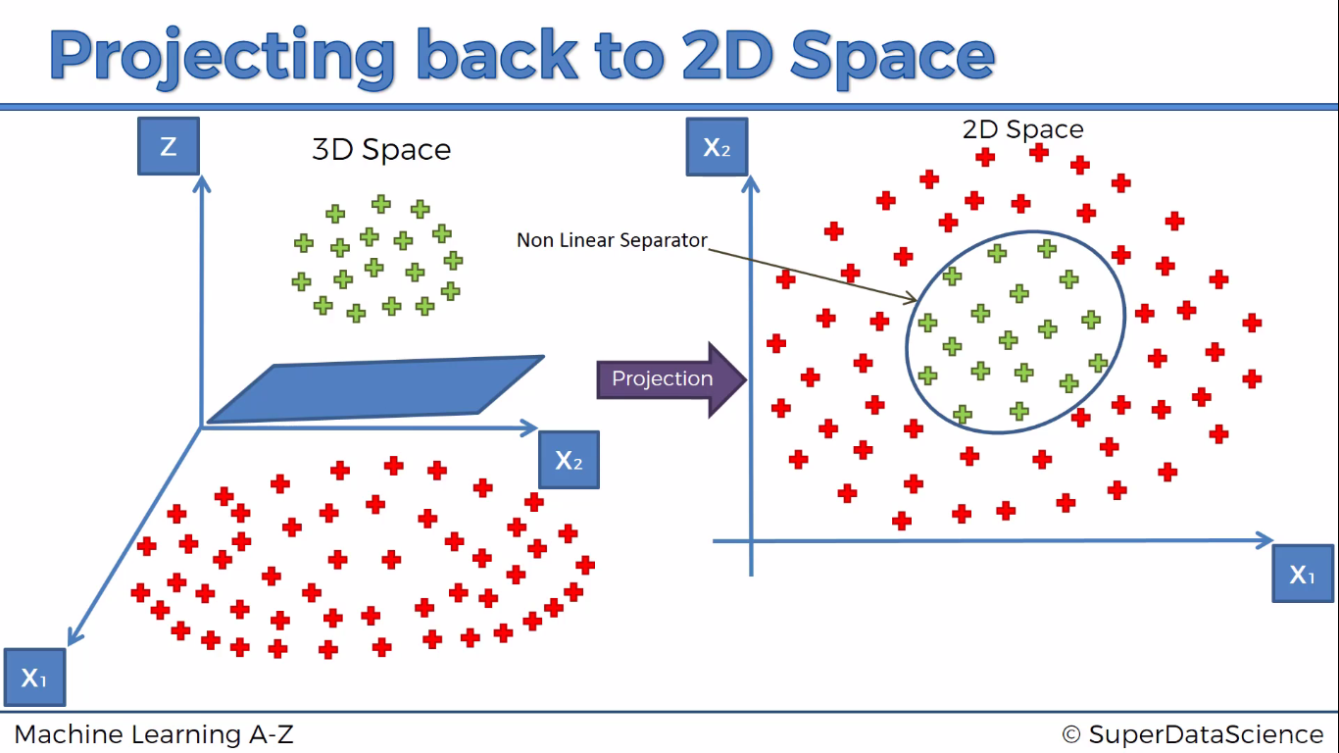

Slide 10
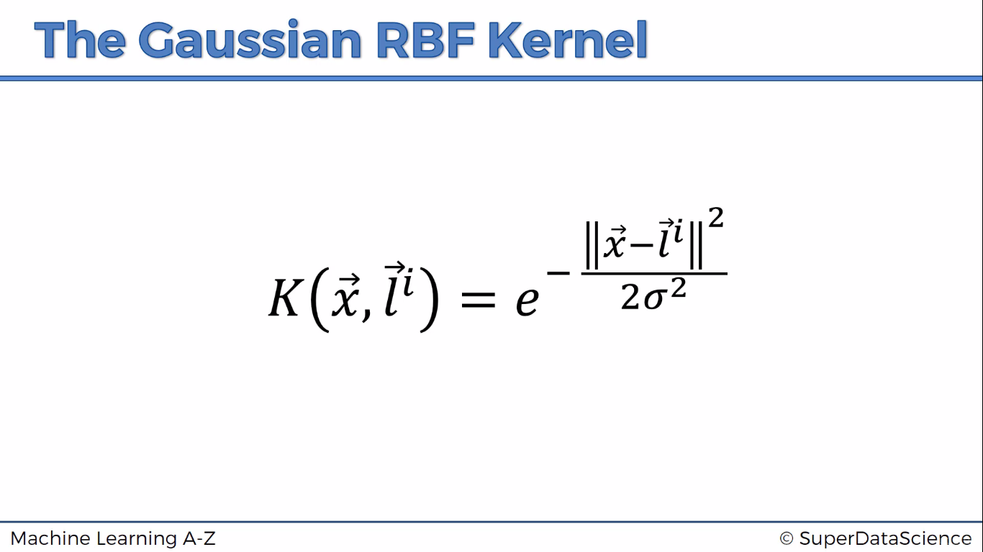

Slide 11
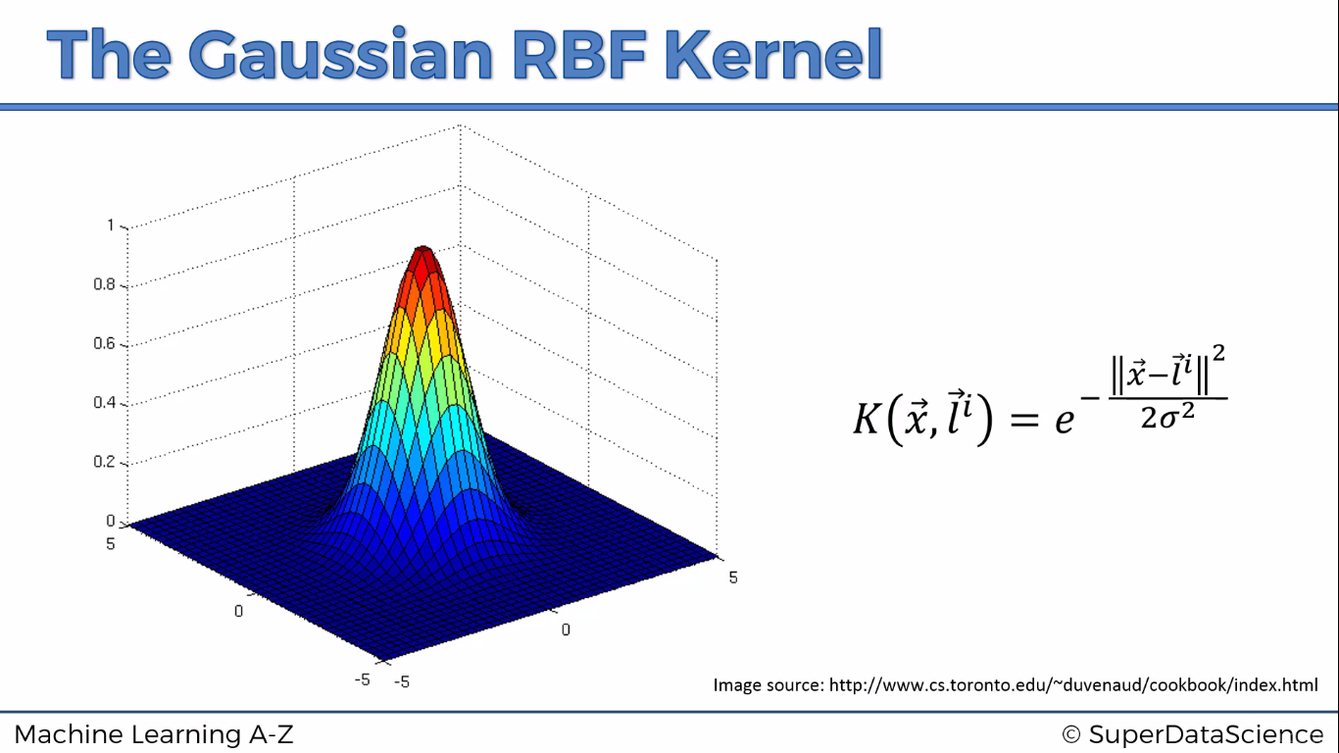

Slide 12


Slide 13
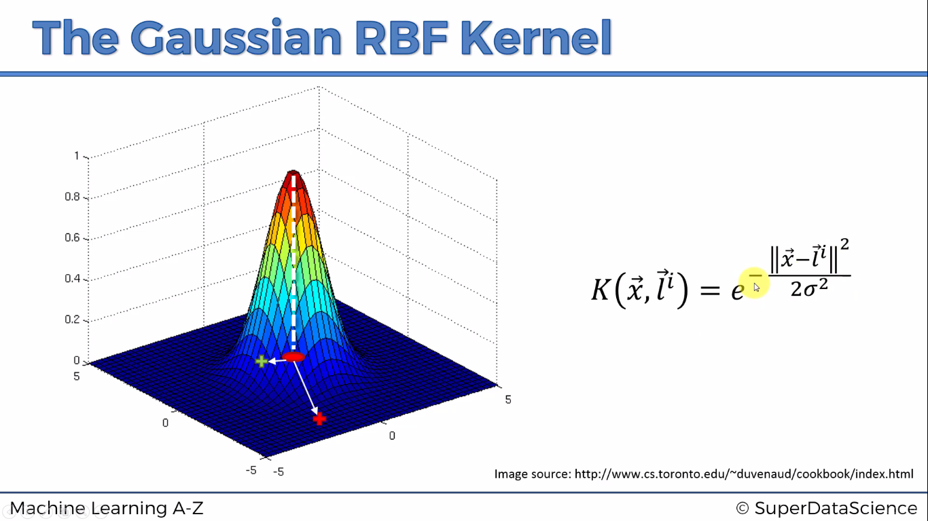

Slide 14
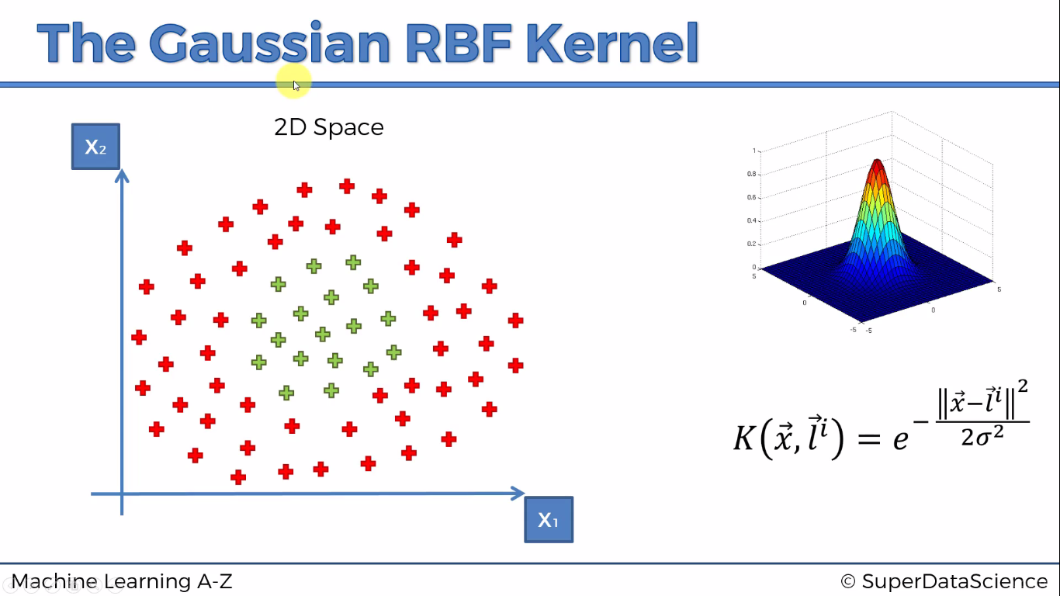

Slide 15
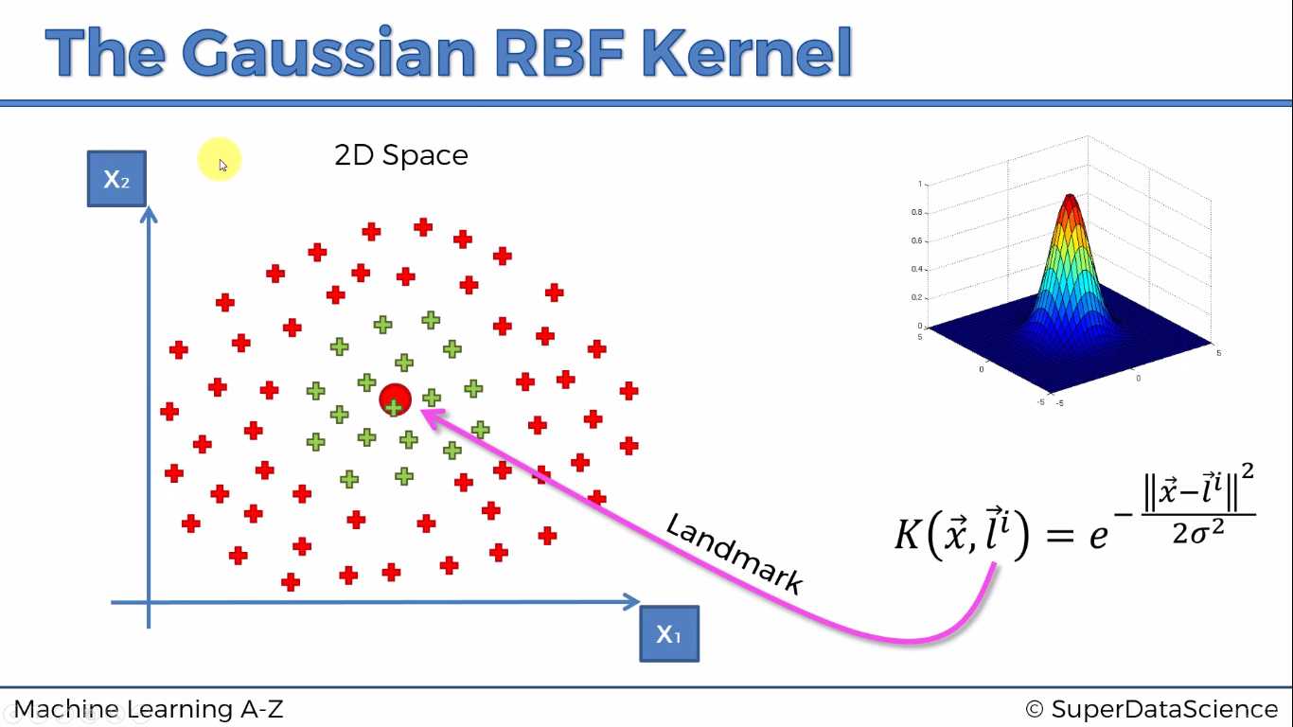

Slide 16
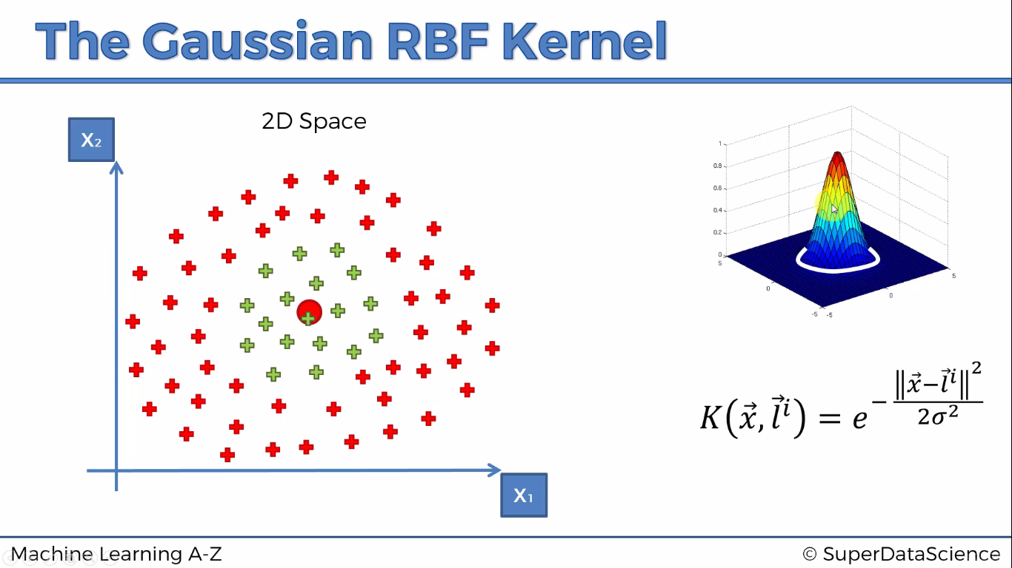

Slide 17
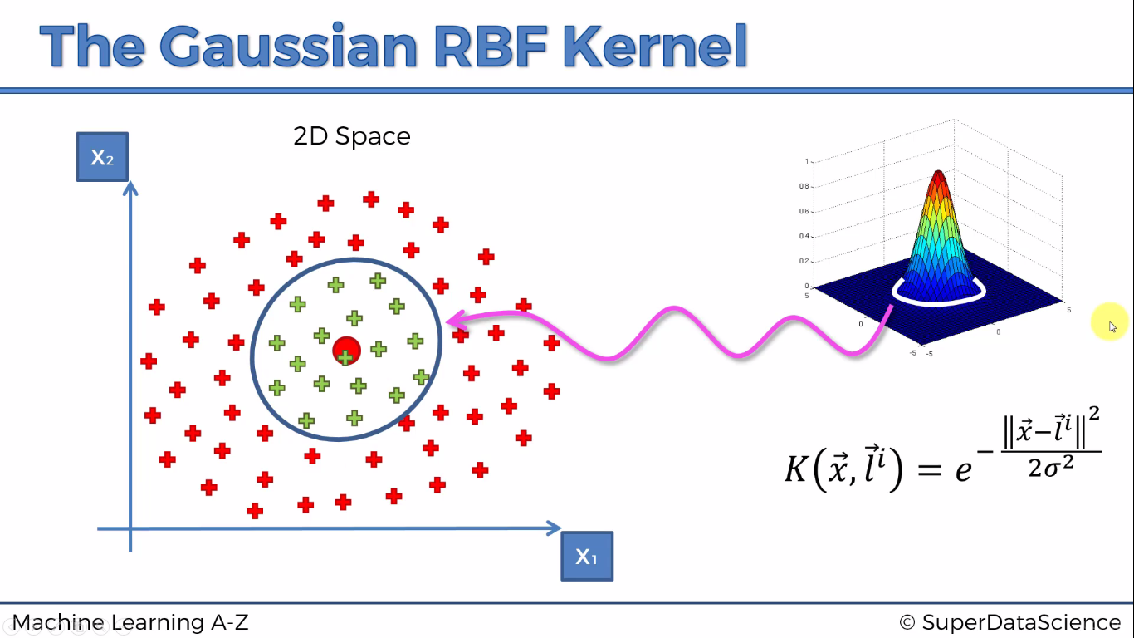

Slide 18
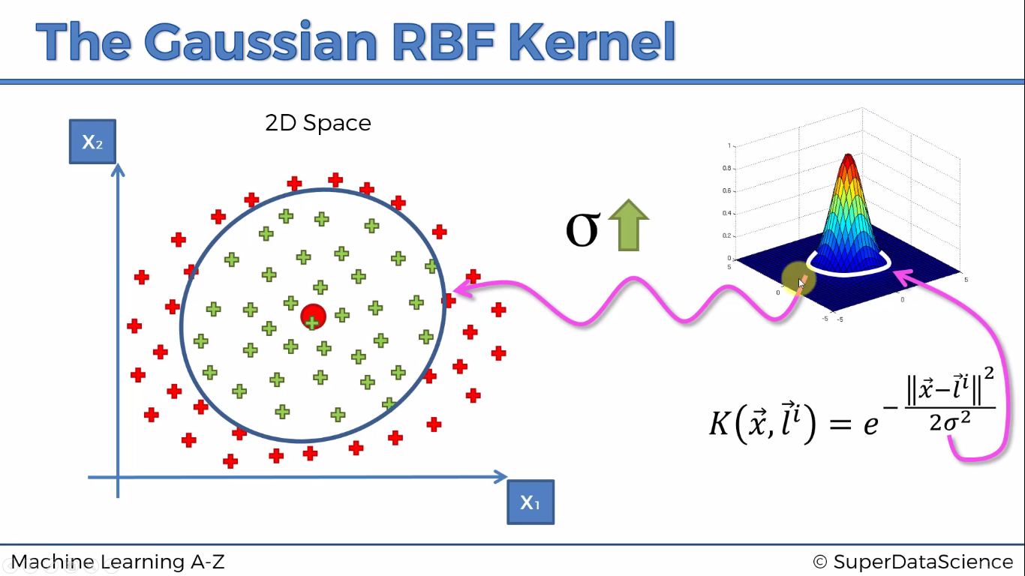

Slide 19
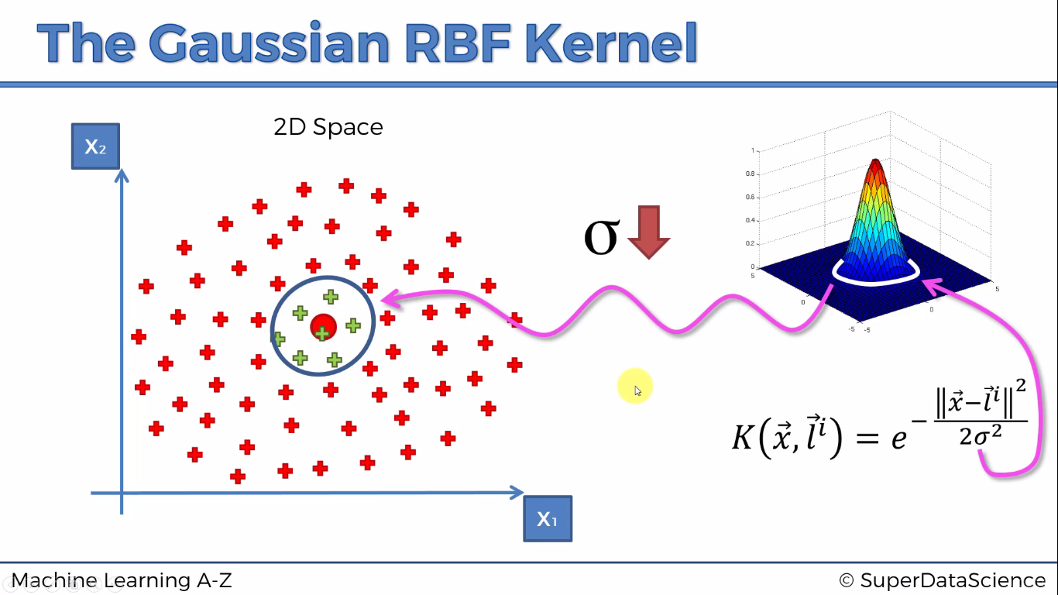

Slide 20
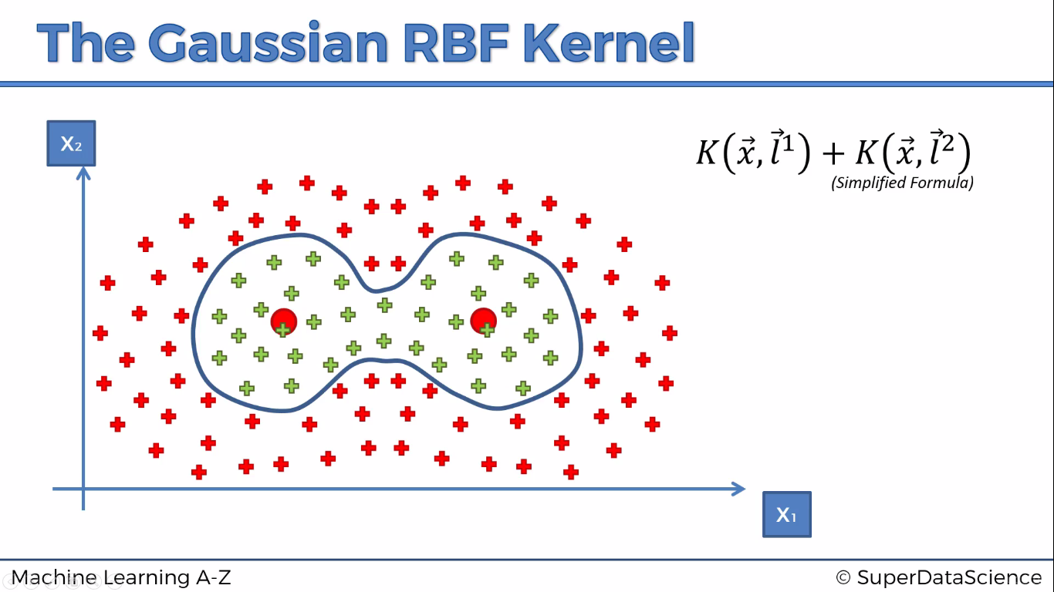

Slide 21
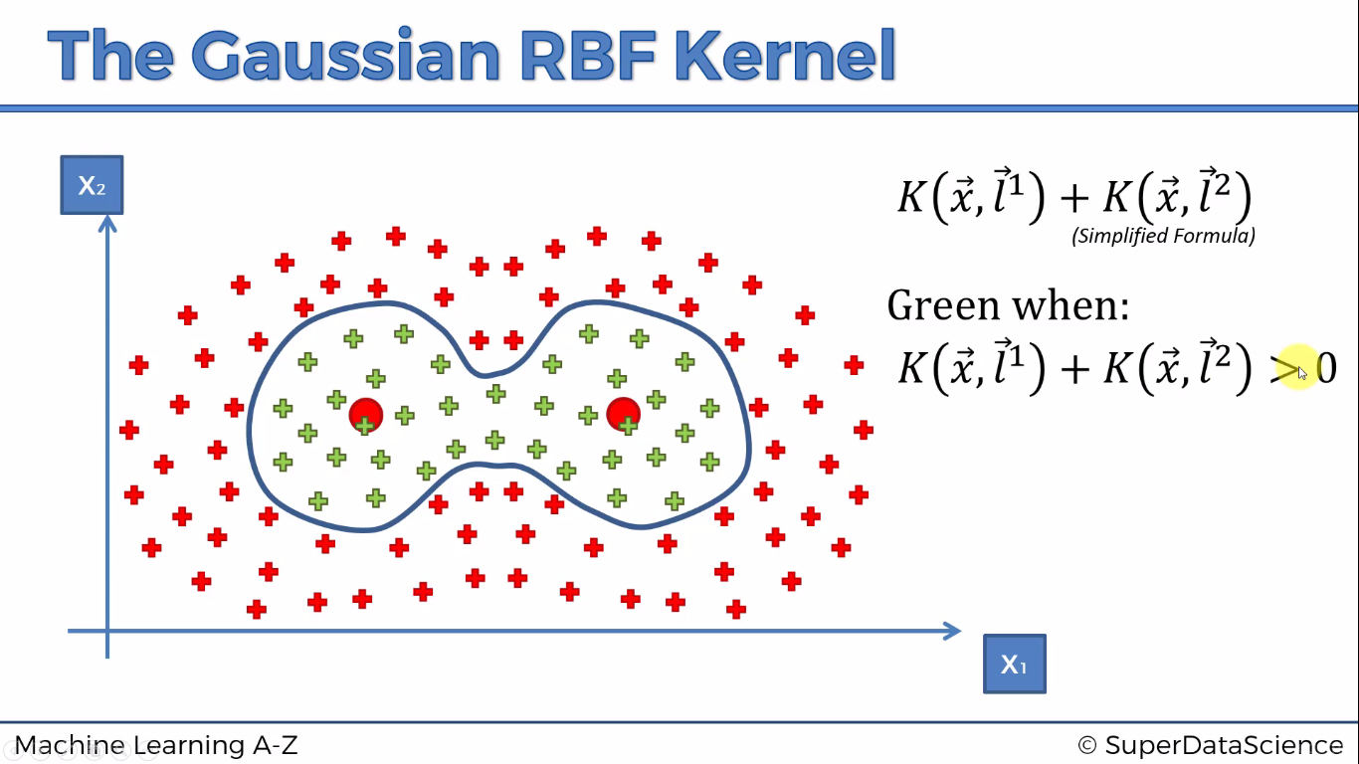

Slide 22
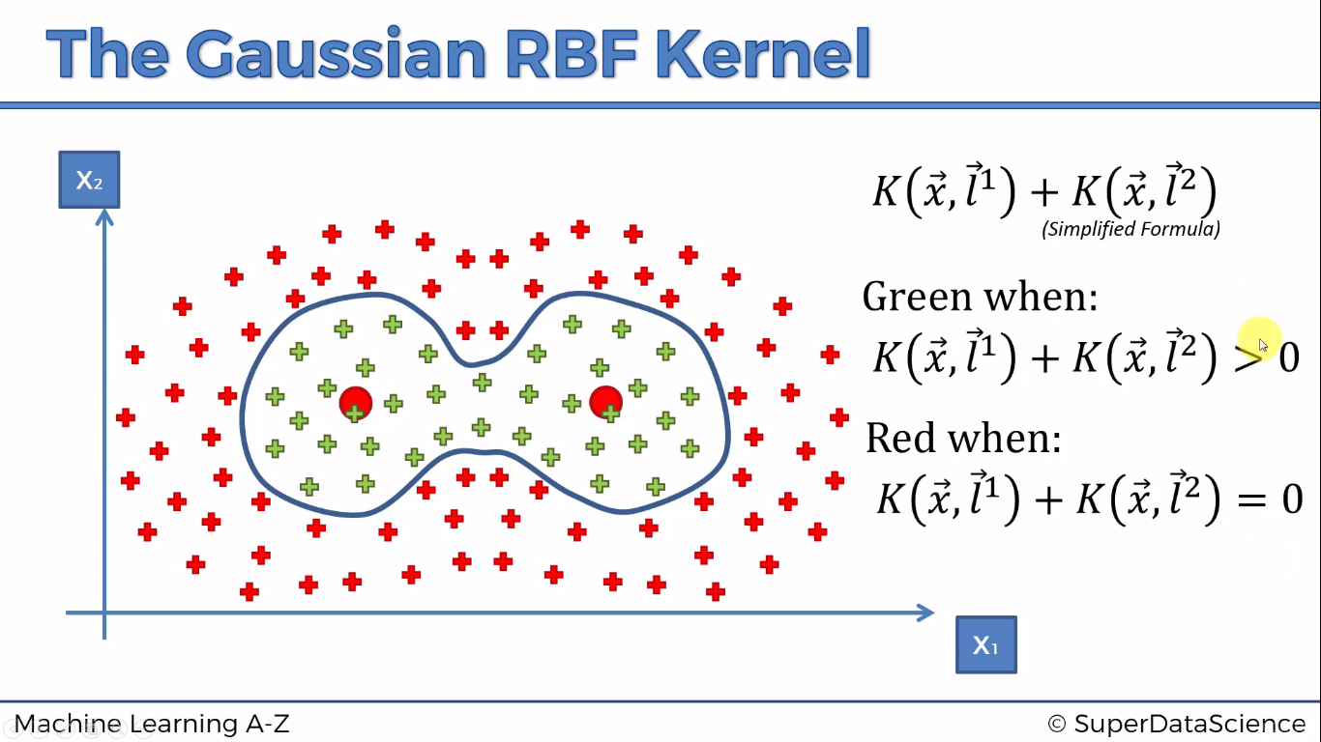

Slide 23
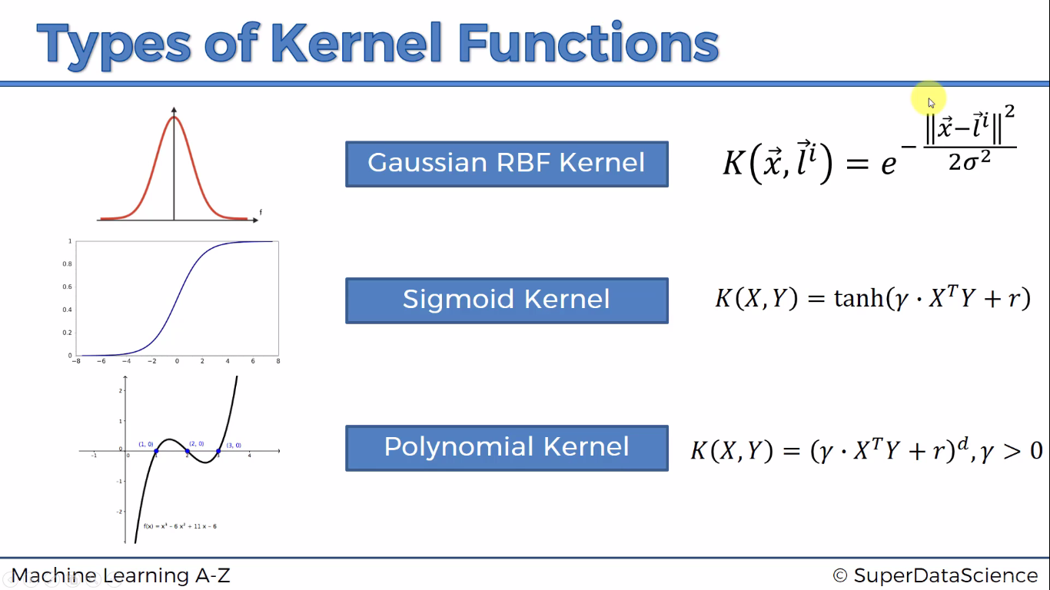

Slide 24

Python

Slide 25
Reading dataset dynamically
from tkinter import *
from tkinter.filedialog import askopenfilename
root = Tk()
root.withdraw()
root.update()
file_path = askopenfilename()
root.destroy()

Slide 26
Importing Libraries
import pandas as pd
import numpy as np
import matplotlib.pyplot as plt

Slide 27
Importing dataset
dataset = pd.read_csv('Social_Network_Ads.csv')
X = dataset.iloc[:,2:4]
y= dataset.iloc[:,-1]

Slide 28
Splitting the dataset into the Training set and Test set
from sklearn.cross_validation import train_test_split
X_train, X_test, y_train, y_test = train_test_split(X, y, test_size = 0.25, random_state = 0)

Slide 29
Feature Scaling
from sklearn.preprocessing import StandardScaler
sc = StandardScaler()
X_train = sc.fit_transform(X_train)
X_test = sc.transform(X_test)

Slide 30
Feature Selection …
Recursive Feature Elimination (RFE) is based on the idea to repeatedly construct a model and choose either the best or worst performing feature, setting the feature aside and then repeating the process with the rest of the features.
This process is applied until all features in the dataset are exhausted. The goal of RFE is to select features.

Slide 31
Fitting classifier to the Training set
from sklearn.svm import SVC
classifier = SVC(kernel = 'linear', random_state = 0)
Or
classifier = SVC(kernel = 'rbf', random_state = 0)
classifier.fit(X_train, y_train)

Slide 32
Confusion Matrix
from sklearn.metrics import confusion_matrix
cm = confusion_matrix(y_test, y_pred)

Slide 33
K fold
from sklearn import model_selection
from sklearn.model_selection import cross_val_score
kfold = model_selection.KFold(n_splits=10, random_state=7)
modelCV = SVC(kernel = 'linear', random_state = 0)
scoring = 'accuracy'
results = model_selection.cross_val_score(modelCV, X_train, y_train, cv=kfold, scoring=scoring)
print("10-fold cross validation average accuracy: %.3f" % (results.mean()))

Slide 34
Prediction
y_pred = classifier.predict(X_test)

Slide 35
Evaluating classification report
from sklearn.metrics import classification_report
print(classification_report(y_test, y_pred))

Slide 36

R

Slide 37
Read dataset
library(readr)
dataset <- read_csv("D:/machine learning AZ/Machine Learning A-Z Template Folder/Part 3 - Classification/Section 14 - Logistic Regression/Logistic_Regression/Social_Network_Ads.csv")
dataset = dataset[3:5]

Slide 38
Encoding the target feature as factor
dataset$Purchased = factor(dataset$Purchased, levels = c(0, 1))

Slide 39
Splitting the dataset into the Training set and Test set
# install.packages('caTools')
library(caTools)
set.seed(123)
split = sample.split(dataset$Purchased, SplitRatio = 0.75)
training_set = subset(dataset, split == TRUE)
test_set = subset(dataset, split == FALSE)

Slide 40
Feature scaling
training_set[-3] = scale(training_set[-3])
test_set[-3] = scale(test_set[-3])

Slide 41
Fitting SVM to the Training set
library(e1071)
classifier = svm(Purchased ~ . ,
data = training_set ,
type = 'C-classification’ ,
kernel = 'linear’)
library(e1071)
classifier = svm(formula = Purchased ~ .,
data = training_set,
type = 'C-classification',
kernel = 'radial')

Slide 42
prediction
y_pred = predict(classifier , newdata = test_set[-3])

Slide 43
Confusion matrix
cm = table(test_set[, 3], y_pred)

